Slide 1
Zambia SMART Survey Findings
May 2024

Slide 2
Background
Zambia is among the countries facing negative effects of climate change with impacts on disease patterns and nutritional disorders.
In the recent past, Zambia has witnessed several nutrition-related challenges, including cholera, floods, dry spells, heat spells, food price inflation, armyworm and cassava brown streak disease.
The Zambia Vulnerability Assessment Committee report released in October 2023 projected that 1,975,843 people would be in critical food insecurity phase between October 2023 and March 2024 (Integrated Food Security Phase (IPC) Acute Food Security (AFI) Phase 3, Crisis), and another 58,400 in emergency food insecurity phase (IPC AFI Phase 4, Emergency), bringing total to 2,037,710 people (339,619 households) requiring humanitarian assistance.
A total of 64 districts were projected to be at IPC AFI Phase 3+ while 12 were projected to have communities at IPC AFI 4.
On 29 February 2024, a national state of emergency was declared because of a severe drought affecting over 50% of Zambia.

Slide 3
Survey Justification
There was no recent reliable data on the prevalence of wasting in Zambia, which directly affected the ability to estimate the caseload requiring nutrition humanitarian interventions.
This could have led to the use of outdated data, with the risk of either significantly over or under-estimating needs, which can lead to either over- or under-resourcing supplies and workforce capacity.
There was therefore need to generate timely, representative, and reliable data using the Standardized Monitoring and Assessment of Relief and Transitions (SMART) survey methodology
SMART is an improved survey method that balances simplicity (for rapid assessment of acute emergencies) and technical soundness.
The SMART Methodology is based on the two most vital and basic public health indicators for the assessment of the magnitude and severity of a humanitarian crisis: nutrition and mortality.

Slide 4
Survey Objectives
Survey Goal
The Goal of the SMART survey was to generate representative province-level data on the nutritional status of children (6-59 months) and women (Reproductive age).
Main objective
The main objective of the SMART surveys was to assess the nutrition status of children (6 to 59 months) and women (reproductive age) using anthropometric data and determine the mortality situation in the country.

Slide 5
Methodology
The SMART surveys adopted a cross-sectional study design using the two-stage cluster sampling based on the SMART methodology.
Aided by the Zambia Statistics Agency, the required number of clusters was selected using probability proportional to population size (PPS).
The anthropometric survey targeted children aged 6-59 months with children 0-23 months targeted for the IYCF survey. All sampled households were targeted for the retrospective mortality survey.
Primary caregivers were interviewed to obtain the required information
Women of reproductive age had their MUAC measurements taken to determine their nutrition status.
SMART+ survey data collection tools and analysis software were used

Slide 6
Surveyed Areas
Domains | Districts
Lusaka Urban (1) | Lusaka urban District
Lusaka Rural (3) | Kafue, Luangwa, Rufunsa
Northwest province (5) | Chavuma, Kabompo, Manyinga, Mufumbwe, Zambezi
Western Province (14) | Mongu, Kalabo, Sikongo, Senanga, Sioma, Shang’ombo, Sesheke, Mulobezi, Mwandi, Nkeyema, Lukulu, Mitete, Limulunga, Nalolo
Central Province (5) | Chitambo, Luano, Serenje, Ngabwe, Shibuyunji
Southern Province (9) | Chikankata, Chirundu, Gwembe, Kazungula, Namwala, Pemba, Salonga, Sinazongwe, Zimba
Eastern province (11) | Chadiza, Chipangali, Chama, Kasenengwa, Lumezi, Lundazi, Lusangazi, Mambwe, Nyimba, Sinda, Vubwi

Slide 7
Targets vs achievement
Domain | HHs planned | HHs reached | % achieved | Children planned | Children reached | % achieved | Eligible children in the HHs | Eligible children measured | Response rate | Clusters planned | Clusters reached | % achieved
Lusaka Urban | 499 | 451 | 90.4% | 338 | 298 | 88.2% | 310 | 298 | 96.1% | 42 | 40 | 95.2%
Lusaka Rural | 515 | 483 | 93.8% | 362 | 320 | 88.4% | 358 | 353 | 98.6% | 43 | 41 | 95.3%
Northwest province | 519 | 508 | 98% | 312 | 390 | 124.9% | 400 | 390 | 97.5% | 40 | 40 | 100%
Western Province | 570 | 549 | 96.3% | 274 | 338 | 123.4% | 342 | 338 | 98.8% | 44 | 43 | 97.7%
Central Province | 584 | 555 | 95.0% | 306 | 417 | 136.3% | 417 | 413 | 99.0% | 42 | 42 | 100%
Southern Province | 585 | 578 | 98.8% | 293 | 467 | 159.3% | 467 | 467 | 100.0% | 45 | 45 | 100%
Eastern province | 528 | 514 | 97.3% | 280 | 404 | 144.3% | 408 | 404 | 99.0% | 48 | 48 | 100%

Slide 8
Survey results

Slide 9
Prevalence of acute malnutrition among children 6-59 months based on MUAC

Slide 10
Domain |  | Wasting by MUAC (and/or oedema) and by sex
 |  | N | GAM |  | Moderate |  | Severe
 |  |  | n | % (95% CI) | n | % (95% CI) | n | % (95% CI)
Lusaka urban | All | 298 | 5 | 1.7% (0.6 - 4.6 95% CI) | 4 | 1.3% (0.5 - 3.5 95% CI) | 1 | 0.3% (0.0 - 2.4 95% CI)
 | Boys | 151 | 3 | 2.0% (0.5 - 8.2 95% CI) | 2 | 1.3% (0.3 - 5.2 95% CI) | 1 | 0.7% (0.1 - 4.7 95% CI)
 | Girls | 147 | 2 | 1.4% (0.3 - 5.4 95% CI) | 2 | 1.4% (0.3 - 5.4 95% CI) | 0 | 0.0% (0.0 - 0.0 95% CI)
Lusaka Rural | All | 352 | 7 | 2.0% (0.7 - 5.3 95% CI) | 5 | 1.4% (0.4 - 5.1 95% CI) | 2 | 0.6% (0.1 - 2.3 95% CI)
 | Boys | 180 | 3 | 1.7% (0.5 - 5.2 95% CI) | 3 | 1.7% (0.5 - 5.2 95% CI) | 0 | 0.0% (0.0 - 0.0 95% CI)
 | Girls | 172 | 4 | 2.3% (0.7 - 7.2 95% CI) | 2 | 1.2% (0.2 - 7.9 95% CI) | 2 | 1.2% (0.3 - 4.6 95% CI)
Northwestern Province | All | 390 | 5 | 1.3% (0.5 - 3.5 95% CI) | 4 | 1.0% (0.3 - 3.3 95% CI) | 1 | 0.3% (0.0 - 1.9 95% CI)
 | Boys | 194 | 5 | 2.6% (0.9 - 6.9 95% CI) | 4 | 2.1% (0.6 - 6.5 95% CI) | 1 | 0.5% (0.1 - 3.9 95% CI)
 | Girls | 196 | 0 | 0.0% (0.0 - 0.0 95% CI) | 0 | 0.0% (0.0 - 0.0 95% CI) | 0 | 0.0% (0.0 - 0.0 95% CI)
Western Province | All | 337 | 4 | 1.2% (0.4 - 3.1 95% CI) | 4 | 1.2% (0.4 - 3.1 95% CI) | 0 | 0.0% (0.0 - 0.0 95% CI)
 | Boys | 169 | 2 | 1.2% (0.3 - 4.6 95% CI) | 2 | 1.2% (0.3 - 4.6 95% CI) | 0 | 0.0% (0.0 - 0.0 95% CI)
 | Girls | 168 | 2 | 1.2% (0.3 - 4.9 95% CI) | 2 | 1.2% (0.3 - 4.6 95% CI) | 0 | 0.0% (0.0 - 0.0 95% CI)
Central Province | All | 412 | 21 | 5.1% (2.9 - 8.9 95% CI) | 20 | 4.9% (2.7 - 8.4 95% CI) | 1 | 0.2% (0.0 - 1.8 95% CI)
 | Boys | 205 | 8 | 3.9% (1.6 - 9.1 95% CI) | 8 | 3.9% (1.6 - 9.1 95% CI) | 0 | 0.0% (0.0 - 0.0 95% CI)
 | Girls | 207 | 13 | 6.3% (3.2 - 12.0 95% CI) | 12 | 5.8% (2.9 - 11.2 95% CI) | 1 | 0.5% (0.1 - 3.6 95% CI)
Southern Province | All | 464 | 12 | 2.6% (1.3 - 5.0 95% CI) | 11 | 2.4% (1.2 - 4.6 95% CI) | 1 | 0.2% (0.0 - 1.6 95% CI)
 | Boys | 241 | 3 | 1.2% (0.4 - 3.7 95% CI) | 3 | 1.2% (0.4 - 3.7 95% CI) | 0 | 0.0% (0.0 - 0.0 95% CI)
 | Girls | 223 | 9 | 4.0% (1.8 - 8.7 95% CI) | 8 | 3.6% (1.6 - 7.9 95% CI) | 1 | 0.4% (0.1 - 3.2 95% CI)
Eastern Province | All | 404 | 4 | 1.0% (0.2 - 4.6 95% CI) | 4 | 1.0% (0.2 - 4.6 95% CI) | 0 | 0.0% (0.0 - 0.0 95% CI)
 | Boys | 205 | 2 | 1.0% (0.2 - 3.8 95% CI) | 2 | 1.0% (0.2 - 3.8 95% CI) | 0 | 0.0% (0.0 - 0.0 95% CI)
 | Girls | 199 | 2 | 1.0% (0.1 - 7.2 95% CI) | 2 | 1.0% (0.1 - 7.2 95% CI) | 0 | 0.0% (0.0 - 0.0 95% CI)

Slide 11
Domain |  | Wasting by weight for height z-scores (and/or oedema) and by sex
 |  | N | GAM |  | Moderate |  | Severe
 |  |  | n | % (95% CI) | n | % (95% CI) | n | % (95% CI)
Lusaka Urban | All | 293 | 11 | 3.8% (2.2-6.3 95% CI) | 11 | 3.8% (2.2-6.3 95% CI) | 0 | 0.0% (0.0 - 0.0 95% CI)
 | Boys | 149 | 9 | 6.0% (3.4-10.5 95% CI) | 9 | 6.0% (3.4-10.5 95% CI) | 0 | 0.0% (0.0 - 0.0 95% CI)
 | Girls | 144 | 2 | 1.4% (0.3-5.6 95% CI) | 2 | 1.4% (0.3-5.6 95% CI) | 0 | 0.0% (0.0 - 0.0 95% CI)
Lusaka Rural | All | 352 | 15 | 4.3% (2.6 - 7.0 95% CI) | 14 | 4.0% (2.3 - 6.7 95% CI) | 1 | 0.3% (0.0 - 2.1 95% CI)
 | Boys | 180 | 7 | 3.9% (1.7 - 8.7 95% CI) | 7 | 3.9% (1.7 - 8.7 95% CI) | 0 | 0.0% (0.0 - 0.0 95% CI)
 | Girls | 172 | 8 | 4.7% (2.4 - 8.7 95% CI) | 7 | 4.1% (2.0 - 8.2 95% CI) | 1 | 0.6% (0.1 - 4.2 95% CI)
Northwestern Province | All | 390 | 11 | 2.8% (1.5 - 5.2 95% CI) | 9 | 2.3% (1.2 - 4.4 95% CI) | 2 | 0.5% (0.1 - 2.1 95% CI)
 | Boys | 194 | 7 | 3.6% (1.8 - 7.0 95% CI) | 5 | 2.6% (1.1 - 5.8 95% CI) | 2 | 1.0% (0.2 - 4.2 95% CI)
 | Girls | 196 | 4 | 2.0% (0.8 - 5.2 95% CI) | 4 | 2.0% (0.8 - 5.2 95% CI) | 0 | 0.0% (0.0 - 0.0 95% CI)
Western Province | All | 337 | 10 | 3.0% (1.4 - 6.1 95% CI) | 9 | 2.7% (1.2 - 5.8 95% CI) | 1 | 0.3% (0.0 - 2.3 95% CI)
 | Boys | 170 | 4 | 2.4% (0.9 - 6.1 95% CI) | 3 | 1.8% (0.6 - 5.3 95% CI) | 1 | 0.6% (0.1 - 4.4 95% CI)
 | Girls | 167 | 6 | 3.6% (1.5 - 8.4 95% CI) | 6 | 3.6% (1.5 - 8.4 95% CI) | 0 | 0.0% (0.0 - 0.0 95% CI)
Central Province | All | 410 | 17 | 4.1%(2 .6 - 6.7 95% CI) | 13 | 3.2% (1.9 - 5.4 95% CI) | 4 | 1.0%( 0.4 - 2.5 95% CI)
 | Boys | 204 | 11 | 5.4% (3.2 - 9.0 95% CI) | 7 | 3.4% (1.7 - 6.9 95% CI) | 4 | 2.0% (0.8 - 5.0 95% CI)
 | Girls | 206 | 6 | 2.9% (1.4 - 6.1 95% CI) | 6 | 2.9% (1.4 - 6.1 95% CI) | 0 | 0.0% (0.0 - 0.0 95% CI)
Southern Province | All | 452 | 28 | 6.2% (4.3 - 8.9 95% CI) | 27 | 6.0% (4.1 - 8.7 95% CI) | 1 | 0.2% (0.0 - 1.7 95% CI)
 | Boys | 233 | 14 | 6.0% (3.4 - 10.4 95% CI) | 14 | 6.0% (3.4 - 10.4 95%CI) | 0 | 0.0% (0.0 - 0.0 95% CI)
 | Girls | 219 | 14 | 6.4% (3.5 - 11.3 95% CI) | 13 | 5.9% (3.1 - 10.9 95%CI) | 1 | 0.5% (0.1 - 3.4 95% CI)
Eastern Province | All | 401 | 7 | 1.7%(0.9 - 3.4 95% CI) | 7 | 1.7% (0.9 - 3.4 95% CI) | 0 | 0.0% (0.0 - 0.0 95% CI)
 | Boys | 204 | 6 | 2.9% (1.4 - 6.1 95% CI) | 6 | 2.9% (1.4 - 6.1 95% CI) | 0 | 0.0% (0.0 - 0.0 95% CI)
 | Girls | 197 | 1 | 0.5% (0.1 - 3.5 95% CI) | 1 | 0.5% (0.1 - 3.5 95% CI) | 0 | 0.0% (0.0 - 0.0 95% CI)

Slide 12
Wasting by weight-for-height z-scores (and/or oedema)

Slide 13
Wasting by weight-for-height z-scores (and/or oedema)
The prevalence of GAM based on WHZ ranged from very low (1.7% ) in Eastern province to medium (6.2%) in the Southern province. The classification is based on the WHO/UNICEF 2018 classification of malnutrition.
There is a significant change in the acute nutrition situation in the Southern province from very low (2.7%) in 2019 to medium (6.2%) in 2024. The prevalence in the other surveys is in the same thresholds as in 2019.
It is worth noting that the surveys were conducted in different seasons (Nov/Dec) in 2019 and May 2024 hence the comparison of findings has been done cautiously.
Active screening and referral is critical to inform on the situation as the emergency evolves.

Slide 14
Prevalence of underweight among children 6-59 months based on WaZ by sex
The prevalence of underweight ranged from 8.7% in Northwestern to 14.7% in Lusaka urban

Slide 15
Domain |  | Underweight by weight for age z-scores and by sex
 |  | N | Global underweight |  | Moderate |  | Severe
 |  |  | n | % (95% CI) | n | % (95% CI) | n | % (95% CI)
Lusaka Urban | All | 292 | 43 | 14.7% (11.1 - 19.3 95% CI) | 37 | 12.7% (9.3 - 17.0 95% CI) | 6 | 2.1% (1.0 - 4.3 95% CI)
 | Boys | 147 | 28 | 19.0% (13.4 - 26.4 95% CI) | 24 | 16.3% (10.8 - 23.9 95% CI) | 4 | 2.7% (1.1 - 6.8 95% CI)
 | Girls | 145 | 15 | 10.3% (5.9 - 17.4 95% CI) | 13 | 9.0% (4.9 - 15.8 95% CI) | 2 | 1.4% (0.3 - 5.4 95% CI)
Lusaka Rural | All | 351 | 40 | 11.4% (8.5 - 15.1 95% CI) | 32 | 9.1% (6.5 - 12.6 95% CI) | 8 | 2.3% (1.2 - 4.4 95% CI)
 | Boys | 180 | 26 | 14.4% (9.5 - 21.4 95% CI) | 19 | 10.6% (6.4 - 17.0 95% CI) | 7 | 3.9% (1.9 - 7.7 95% CI)
 | Girls | 171 | 14 | 8.2% (5.0 - 13.2 95% CI) | 13 | 7.6% (4.5 - 12.6 95% CI) | 1 | 0.6% (0.1 - 4.2 95% CI)
Northwestern province | All | 390 | 34 | 8.7% (6.1 - 12.4 95% CI) | 32 | 8.2% (5.6 - 11.9 95% CI) | 2 | 0.5% (0.1 - 2.1 95% CI)
 | Boys | 194 | 19 | 9.8% (6.4 - 14.7 95% CI) | 17 | 8.8% (5.6 - 13.4 95% CI) | 2 | 1.0% (0.2 - 4.2 95% CI)
 | Girls | 196 | 15 | 7.7% (4.5 - 12.7 95% CI) | 15 | 7.7% (4.5 - 12.7 95% CI) | 0 | 0.0% (0.0 - 0.0 95% CI)
Western Province | All | 337 | 47 | 13.9% (10.0 - 19.1 95% CI) | 42 | 12.5% (8.9 - 17.1 95% CI) | 5 | 1.5% (0.4 - 5.4 95% CI)
 | Boys | 170 | 28 | 16.5% (11.5 - 23.0 95% CI) | 25 | 14.7% (10.2 - 20.8 95% CI) | 3 | 1.8% (0.4 - 7.6 95% CI)
 | Girls | 167 | 19 | 11.4% (7.2 - 17.6 95% CI) | 17 | 10.2% (6.3 - 16.0 95% CI) | 2 | 1.2% (0.3 - 4.9 95% CI)
Central Province | All | 412 | 60 | 14.6% (11.2 - 18.7 95% CI) | 40 | 9.7% (7.3 - 12.7 95% CI) | 20 | 4.9% (3.0 - 7.9 95% CI)
 | Boys | 205 | 36 | 17.6% (12.8 - 23.5 95% CI) | 21 | 10.2% (6.9 - 15.0 95% CI) | 15 | 7.3% (4.4 - 12.0 95% I)
 | Girls | 207 | 24 | 11.6% (7.9 - 16.8 95% CI) | 19 | 9.2% (6.2 - 13.5 95% CI) | 5 | 2.4% (1.0 - 5.7 95% CI)
Southern Province | All | 461 | 62 | 13.4% (10.1 - 17.7 95% CI) | 49 | 10.6% (7.6 - 14.7 95% CI) | 13 | 2.8% (1.5 - 5.2 95% CI)
 | Boys | 240 | 30 | 12.5% (8.3 - 18.3 95% CI) | 25 | 10.4% (6.6 - 16.0 95% CI) | 5 | 2.1% (0.8 - 5.5 95% CI)
 | Girls | 221 | 32 | 14.5% (9.9 - 20.7 95% CI) | 24 | 10.9% (7.3 - 16.0 95% CI) | 8 | 3.6% (1.6 - 8.2 95% CI)
Eastern Province | All | 401 | 51 | 12.7% (8.4 - 18.8 95% CI) | 47 | 11.7% (7.9 - 17.1 95% CI) | 4 | 1.0% (0.4 - 2.6 95% CI)
 | Boys | 203 | 32 | 15.8% (9.6 - 24.9 95% CI) | 30 | 14.8% (9.2 - 23.0 95% CI) | 2 | 1.0% (0.3 - 3.8 95% CI)
 | Girls | 198 | 19 | 9.6% (5.3 - 16.9 95% CI) | 17 | 8.6% (4.9 - 14.7 95% CI) | 2 | 1.0% (0.2 - 4.1 95% CI)

Slide 16
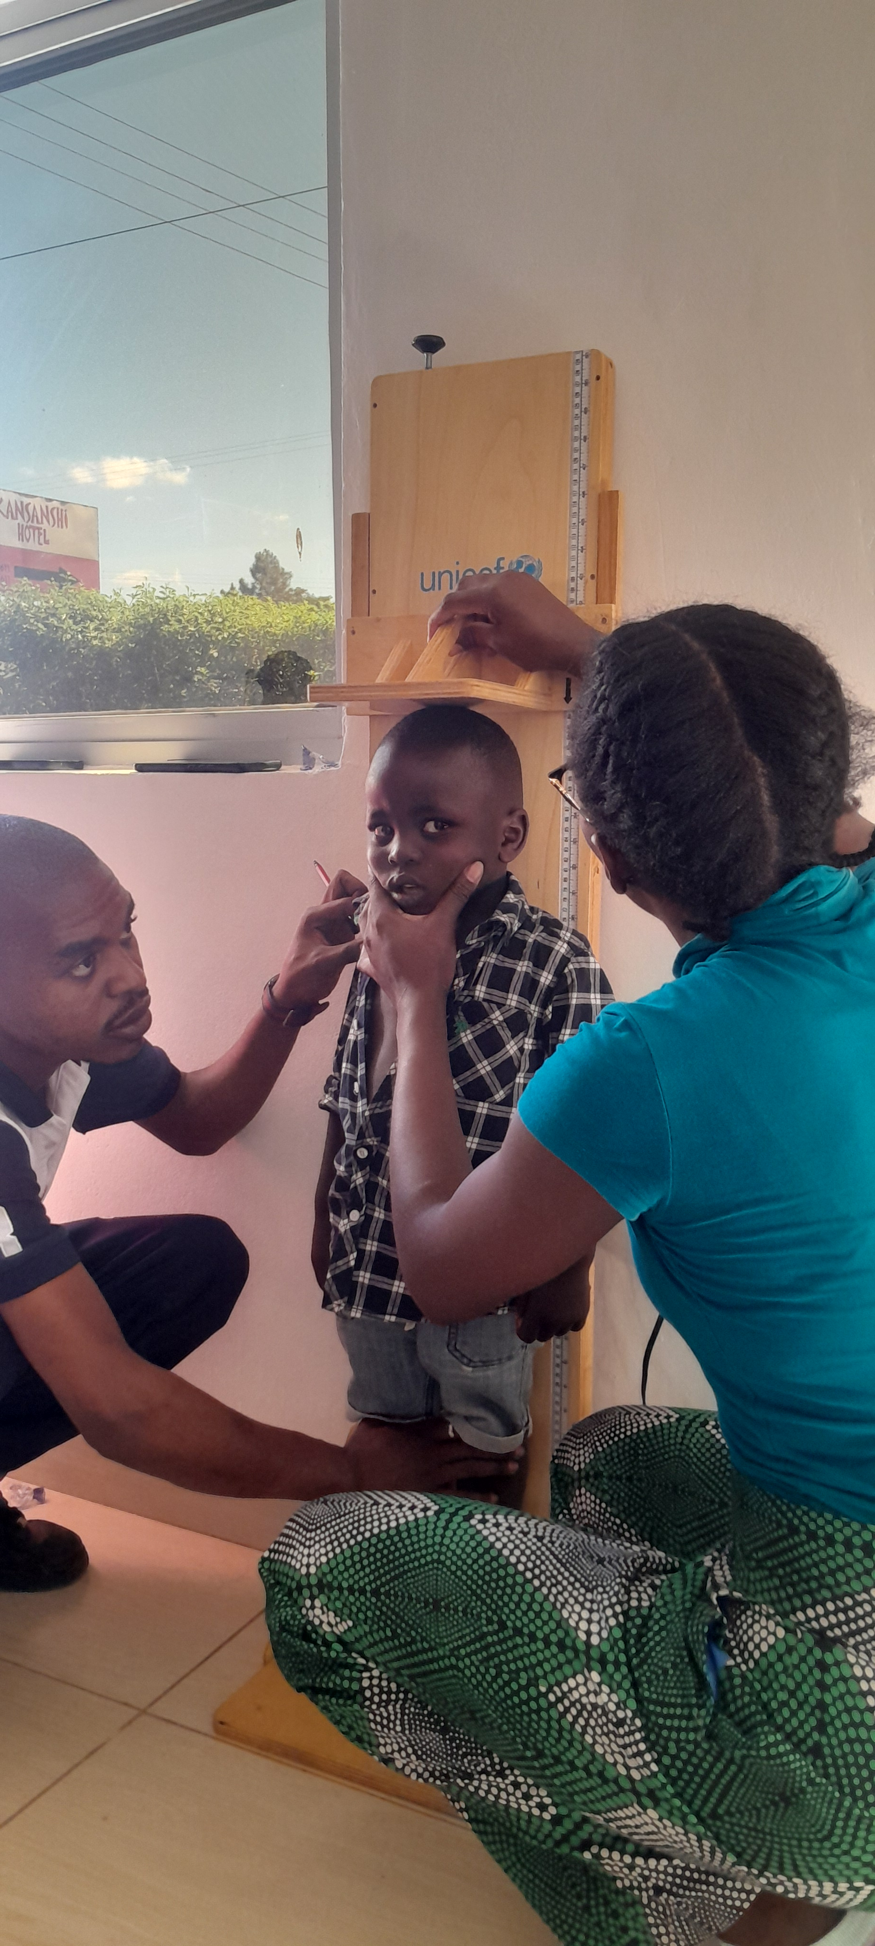
Chronic malnutrition - HAZ
The results unveiled high to very high stunting prevalence, ranging from high in the Western (26.1%) to very high in the Eastern province (34.6%)

Slide 17
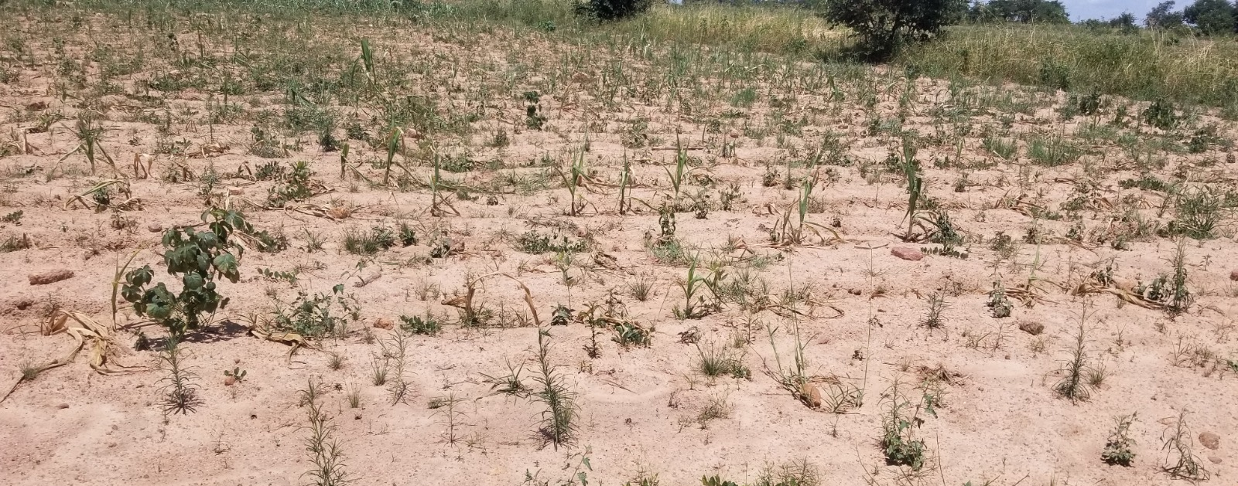
Household hunger scale
The assessment of hunger 30 days before the survey indicates that more than half of the households experienced hunger in the household except for the Lusaka urban survey.
The worsening trends may likely exacerbate the nutrition situation in both acute and chronic malnutrition

Slide 18
Household hunger scale
The Western province population assessment indicated almost half (48.2%) of the households experienced severe hunger, while in Southern province, 17.8% experienced severe hunger.
Domain | Household Hunger Score by category
 | Number of Households | Little to no hunger in the household | Moderate Hunger in the household | Severe Hunger in the household
Lusaka urban | 448 | 72.1% (323) | 25.2% (113) | 2.7% (12)
Lusaka Rural | 486 | 42.4% (206) | 47.3% (230) | 10.3% (50)
Northwestern province | 503 | 15.7% (79) | 72.0% (362) | 12.3% (62)
Western province | 544 | 11.4% (62) | 40.4% (220) | 48.2% (262)
Central province | 554 | 44.4% (246) | 52.5% (291) | 3.1% (17)
Southern Province | 578 | 26.8% (155) | 55.4% (320) | 17.8% (103)
Eastern Province | 512 | 29.9% (153) | 58.8% (301) | 11.3% (58)

Slide 19
Infant and young child feeding
Exclusive Breastfeeding for children under 6 months ranged from 46.4% in Lusaka urban to 74.2% in Eastern province. Bottle feeding was highest in Lusaka at 25.2% among children 0-23 month.
Dietary diversity for children above 6 months ranged from 12.3% in Western province to 37.9% in Central province. Eastern province (61.8%) and Lusaka urban (53.5%) recorded a higher diversity compared to the other provinces.
Minimum Acceptable Diet (MAD) of children 6-23 months ranged from 2.5% in Western province to 12.7% in Lusaka Rural districts. Lusaka Urban and Eastern Province recorded a higher MAD of 26.3% and 24.3% respectively.
Generally there was low consumption of flesh foods and vegetables in all the provinces assessed, which may be attributed to both unavailability and cultural practices around food consumption.
Lusaka urban survey showed high consumption of unhealthy foods for children 6-23 months (39.1%) and sweet beverages (60%)

Slide 20
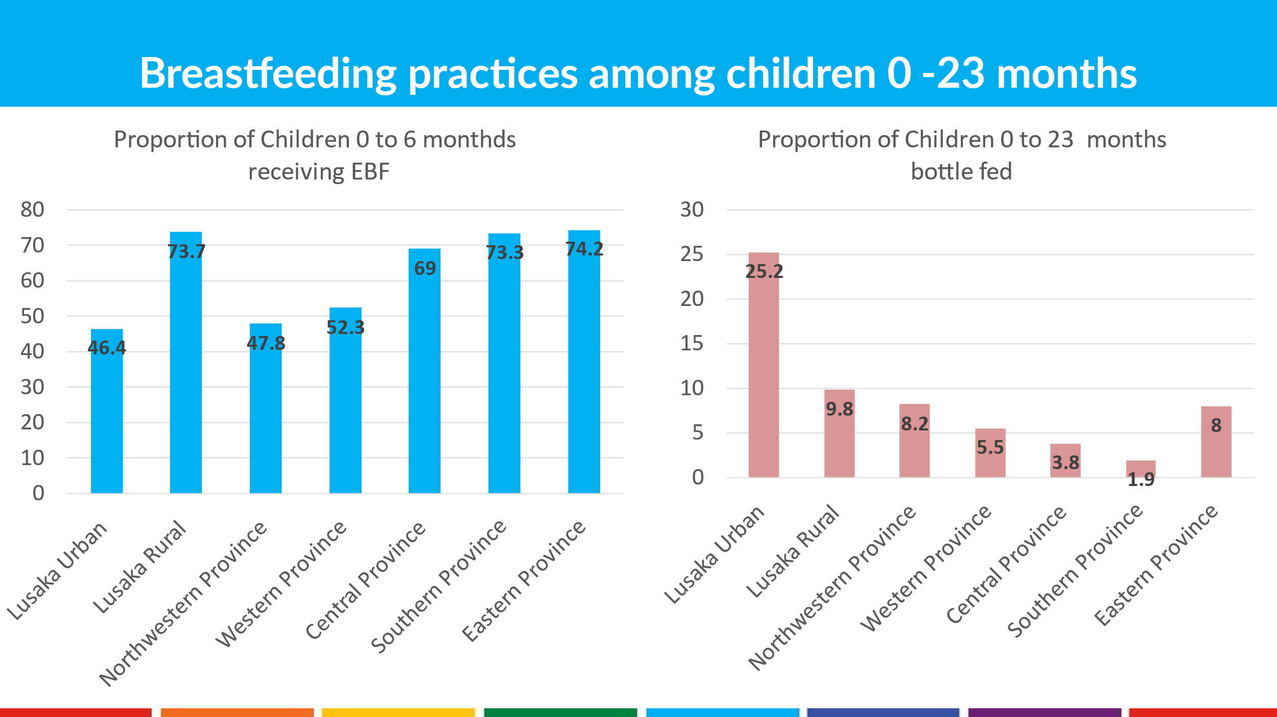
Chart 4: Breastfeeding practices among children 0-23 months in Zambia, May 2024

Slide 21
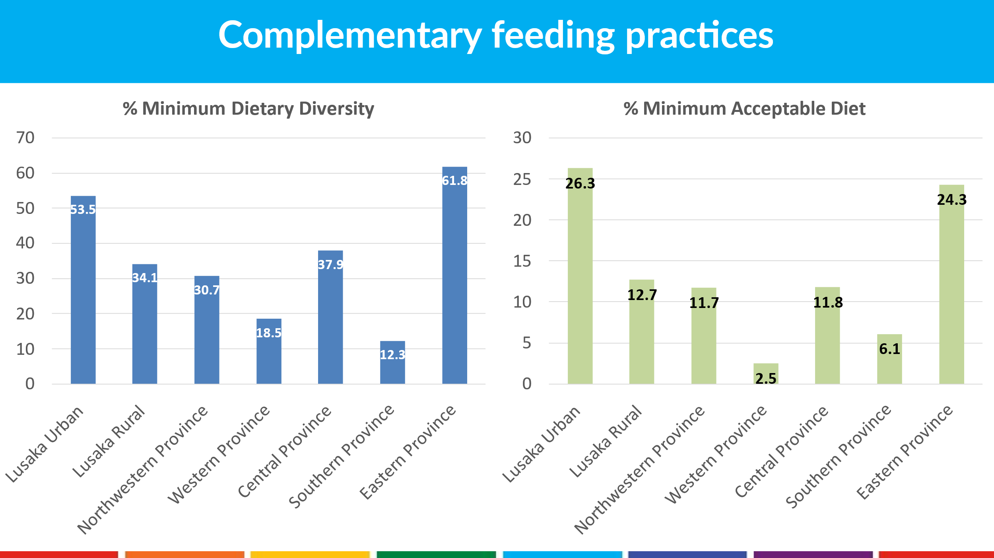

Slide 22
Morbidity and Treatment-seeking behaviour
A third of the children in all the provinces reported to have had watery diarrhoea 2 weeks before the survey ranging from 17.1% in Western to 33.4% in Eastern province.
Management of diarrhoea with both Zinc and ORS was low with only half of the children with diarrhoea receiving treatment. Most of the children used homemade ORS mixtures as advised by healthcare workers.
Treatment seeking for all the illnesses at health facilities was >80%

Slide 23
Vitamin A supplementation, deworming and measles vaccination
The coverage of Vitamin A supplementation, deworming, and measles vaccination were all below the recommendation of >95%. A notable proportion of children confirmed supplementation/vaccination by recall, indicating a gap in the documentation at the health facilities.

Slide 24
Vitamin A supplementation, deworming & measles
Domain | Children 6-59 months who received vitamin A last 6 months |  |  |  | Children 12-59 months who received deworming last 6 months |  |  | Children 9-59 months who received measles vaccine
 | Yes, card | Yes, recall | No or don't know | N | Yes | No | N | Yes, card | Yes, recall | No or don't know | N
Lusaka Urban | 47.4% (147) | 24.5% (76) | 28.1% (87) | 310 | 70.8% (182) | 29.2% (75) | 257 | 67.9% (201) | 27.0% (80) | 5.1% (15) | 296
Lusaka Rural | 53.4% (190) | 18.5% (66) | 28.1% (100) | 356 | 71.7% (218) | 28.3% (86) | 304 | 74.5% (251) | 21.1% (71) | 4.5% (15) | 337
Northwestern Province | 67.2% (269) | 12.5% (50) | 20.3% (81) | 400 | 82.9% (276) | 17.1% (57) | 333 | 80.9% (305) | 12.2% (46) | 6.9% (26) | 377
Western Province | 57.3% (196) | 31.3% (107) | 11.4% (39) | 342 | 78.9% (228) | 21.1% (61) | 289 | 69.6% (224) | 25.5% (82) | 5.0% (16) | 322
Central Province | 50.1% (209) | 22.5% (94) | 27.3% (114) | 417 | 61.9% (211) | 38.1% (130) | 341 | 62.3% (248) | 16.6% (66) | 21.1% (84) | 398
Southern Province | 60.8% (284) | 30.0% (140) | 9.2% (43) | 467 | 79.6% (323) | 20.4% (83) | 406 | 74.8% (333) | 21.1% (94) | 4.0% (18) | 445
Eastern Province | 59.1% (241) | 29.4% (120) | 11.5% (47) | 408 | 90.7% (312) | 9.3% (32) | 344 | 62.1% (241) | 30.4% (118) | 7.5% (29) | 388

Slide 25
Women’s health
Domain | Prevalence of Acute Malnutrition Among Pregnant and Breastfeeding with infant less than 6 months |  |  | Prevalence of Acute Malnutrition Among non pregnant and lactating women of Reproductive age (15-49 years) |  | Number of Non pregnant and non lactating women aged 15-49 years
 | Global Acute malnutrition (< 230 mm) | Severe Acute Malnutrition Among (MUAC < 210 mm) | No of PBW | Global Acute Malnutrition Among WRA (MUAC <230 mm) | Severe Acute Malnutrition Among WRA (MUAC < 210 mm)
Lusaka urban | 6.3% (4) | 0.0% (0) | 64 | 8.7% (41) | 0.8% (4) | 527
Lusaka Rural | 10.3% (7) | 0.0% (0) | 68 | 10.5% (42) | 1.7% (7) | 401
Northwestern Province | 9.3% (8) | 0.0% (0) | 86 | 11.2% (52) | 1.7% (8) | 464
Western Province | 13.5% (12) | 4.5% (4) | 89 | 15.6% (64) | 2.7% (11) | 409
Central Province | 14.7% (10) | 2.9% (2) | 68 | 14.1% (69) | 3.9% (19) | 488
Southern Province | 10.4% (10) | 1.0% (1) | 96 | 10.7% (60) | 1.2% (7) | 561
Eastern province | 9.2% (7) | 0.0% (0) | 76 | 10.2% (37) | 1.1% (4) | 364

Slide 26
Water, Hygiene and Sanitation
Only a small proportion of households had a specific handwashing device, as low as 2.9% in Western and 3.2% in Central. Lusaka urban (20.5% ) and Southern Province (26.3%) were highest
Access to unimproved sanitation facilities was high in all the provinces ranging from 63.9% in Lusaka Rural Districts to 88.9% in Eastern province.
Positive to note, more than half of the households accessed drinking and cooking water from protected/safe sources with 51.8% in central province to 100% in the Lusaka urban district.
Access to a sufficient amount of safe water ranged from 37.3% in Central province to 74.5% in Lusaka urban district.

Slide 27
Mortality
Both the Crude Death Rate and Under 5 Death Rate were below the WHO emergency thresholds of 1/10,000/day and 2/10,000/day respectively.
Domain | Crude mortality rate |  | Under five mortality rate |  | Total Population Sampled | Number of households
 | (total deaths /10,000 people / day) |  | (deaths in children under five / 10,000 children under five / day)
 | Rate [CI] | Design Effect | Rate [CI] | Design Effect
Lusaka Urban | 0.39 (0.20-0.77) | 1.00 | 0.00 (0.00-12.02) | 1.00 | 2230 | 451
Lusaka Rural | 0.37 (0.18-0.77) | 1.06 | 0.31 (0.05-1.82) | 1.00 | 2576 | 487
Northwestern Province | 0.08 (0.02-0.28) | 1.00 | 0.00 (0.00-11.44) | 1.00 | 3176 | 508
Western Province | 0.30 (0.14-0.68) | 1.17 | 0.63 (0.16-2.37) | 1.00 | 2816 | 549
Central Province | 0.38 (0.22-0.65) | 1.00 | 0.80 (0.27-2.34) | 1.00 | 3238 | 555
Southern Province | 0.19 (0.08-0.43) | 1.00 | 0.47 (0.13-1.74) | 1.00 | 3203 | 578
Eastern Province | 0.17 (0.07-0.43) | 1.00 | 0.55 (0.14-2.05) | 1.00 | 2832 | 514
Interpretation of death rates per 2018 Sphere Standards

Slide 28
Recommendations

Slide 29
Recommendations
Early action is urgently required in all survey areas but priority should be given to Southern, Western, North-Western and Central Provinces to avert a nutritional crisis.
Pregnant and lactating women, and children under five should be prioritized in food distribution and/or emergency cash transfer interventions, with a food package that includes both calories and protein.
Micronutrient supplementation during pregnancy should go beyond iron and folate and provide an array of micronutrients of public health importance, through provision of multiple micronutrient supplements.
As the emergency evolves, it is critical to improve the completeness, quality and frequency of routine data to monitor nutrition situation, while timely identifying and treating children with malnutrition through active case finding.
Expand treatment capacity to every Primary Health Care facility ahead of the lean season, to prepare for anticipated increase in severe wasting.

Slide 30
Recommendations
Enforcement of the Code of marketing of breastmilk substitutes and intensifiy nutrition education sessions, using appropriate behavior change communication interventions such as breastfeeding/complementary feeding cooking demonstrations and appropriate IEC materials.
Increase health campaigns to improve coverage of vitamin A supplementation, deworming, and measles vaccination especially in less accessible areas.
More efforts and resources are required for stunting prevention through different multi-sectoral interventions combining mother’s nutrition, infant and young child feeding, water, sanitation and hygiene practices, as well as other nutrition related interventions such as improving access to basic health services, improving food security, among other interventions.

Slide 31
Current actions
Treatment
The nutrition target for the treatment of severe acute malnutrition in children 6 to 59 months is 51,044. Of these 5,691 children received care and treatment in the first five months. This translates into 11%.
Out of the 137,513 children targeted for treatment of Moderate Acute Malnutrition, 13,799 were reached and this translates into 10%.
Treatment of Acute Malnutrition in Pregnant and Lactating women hasn’t started since procurement of commodities has just been initiated.
The number of cartons targeted for procurement is 51,044 of which 8,954 has already been distributed to health facilities while procurement of 47,824 cartons is in the pipeline through the MoH/UNICEF nutrition match fund initiative.

Slide 32
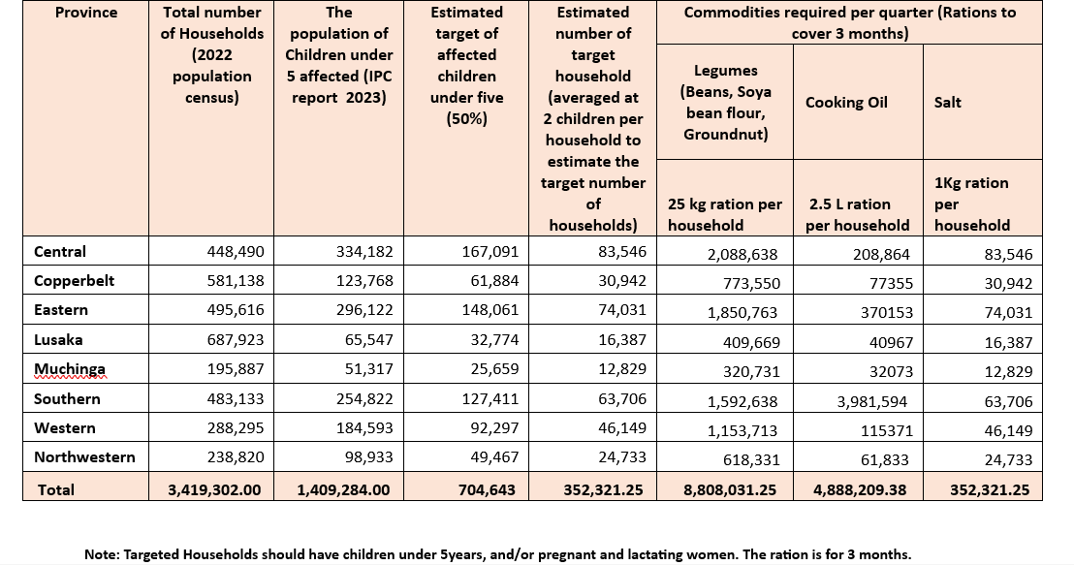
Current actions
Prevention
GRZ relief food recommendation- 50 kg of Maize; 12.5 Kg of legume; 2.5 L of cooking oil and 1 kg of salt per household per month.

Slide 33
Current actions
Capacity building of National and Sub-national level staff in Nutrition and Emergency response
20 districts targeted
Nutrition clusters at sub-national level

Slide 34
Detailed Report ready for circulation to all stakeholders.

Slide 35
THANK YOU

